Slide 1
BUS ADM 744
with
Hugh Morris
Information
Strategy
&
Management
Technology
Session #5
Strategic Planning
Designing Corporate Infrastructure
BUS ADM 744 Fall Semester 2017

Slide 2
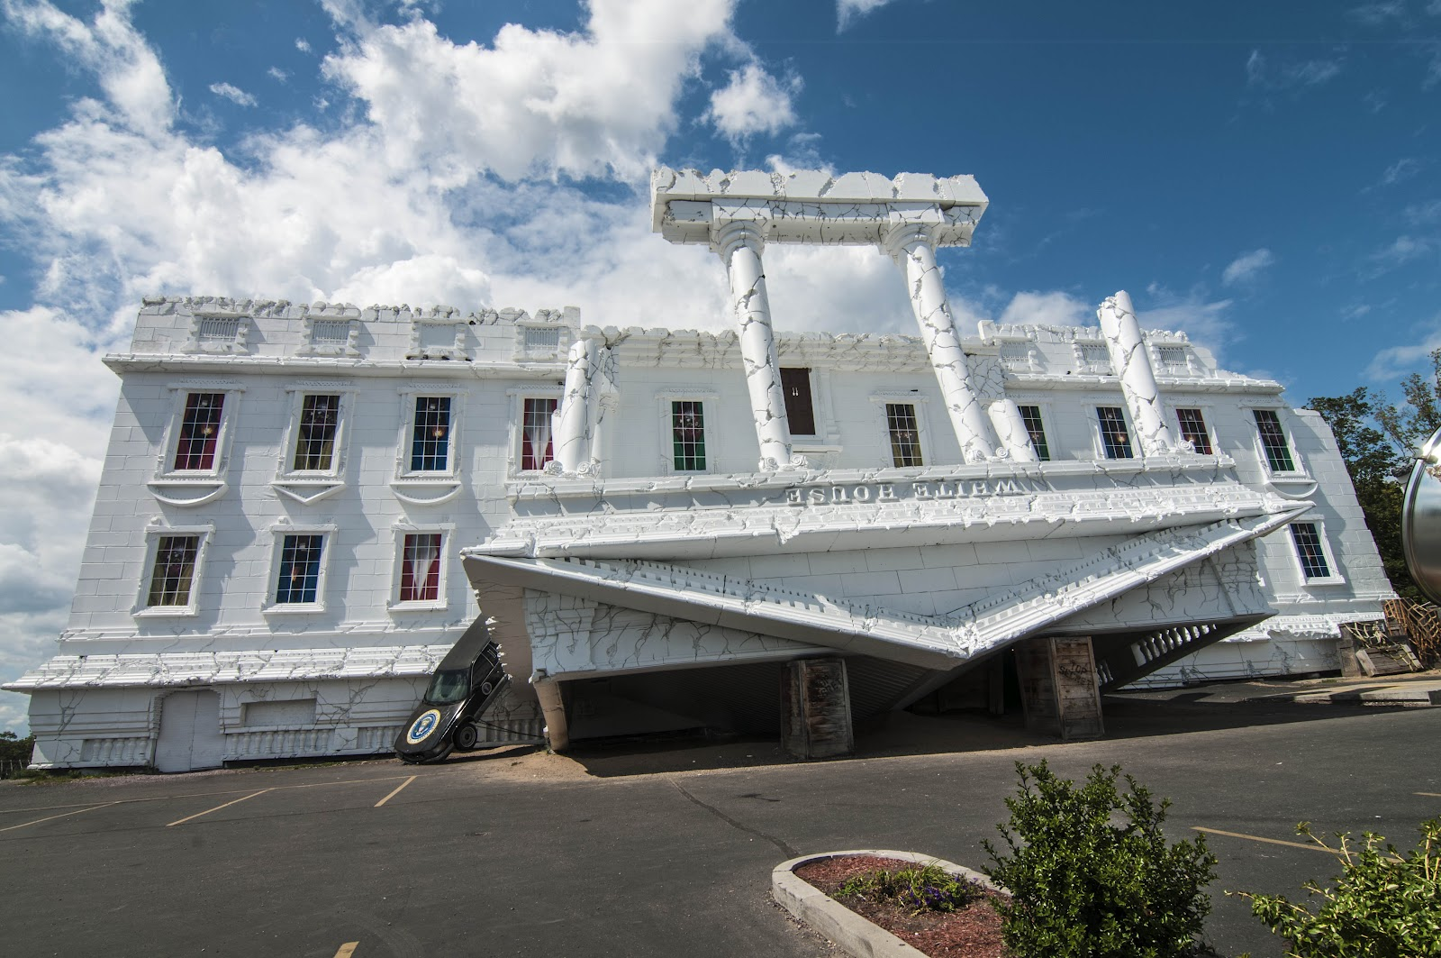
IT Architecture
Designing Corporate IT Architecture

Slide 3
IT Architecture
IT architecture versus IT infrastructure
Architecture (conceptual)
Guiding principles
Example
Blueprint
Application, Information
Technology
Infrastructure (physical)
Implementation of an architecture
hardware, software, networks, processes, data, …
Example
Application architecture for distributed systems

Slide 4
IT Architecture
Evolution of Distributed Systems
Mainframe → Client-server → Web
Centralization vs Decentralization
Attributes of Distributed Systems
Degree to which a system is distributed is dependent on:
Where the processing is done
How processors and other devices are interconnected
Where the information is stored
What rules or standards are used

Slide 5
IT Architecture
Corporate Policy for Distributed Computing
IS has to decide when and to what degree computing at the corporate level should be distributed.
Hardware, software, networking, processing, storage
Responsibility should not be placed on individual end users and departments
… no specific policy on “distributedness”,
rather a “best technical fit for purpose” policy
> policies should focus on compliance and governance

Slide 6
IT Architecture
Types of Enterprise Distributed Systems
Host-based Hierarchy
Main host to number of clients
Decentralized Stand-Alone Systems
“Islands of Computing” (not distributed really)
Peer-to-Peer Systems
No hierarchy or ‘superior’ computer
Hybrid Systems
Combination

Slide 7
IT Architecture
Types of Enterprise Distributed Systems
Client-Server Systems
Splits computing workload between client and server
Presentation
Application
Data
Three-tier architecture
Multi-tier (or N-tier) architecture

Slide 8
IT Architecture
Client Server Computing

Slide 9
IT Architecture
Client Server Arrangements
Examples
Web applications
Mobile applications
Remote Desktop or Citrix
Web Services / SOA

Slide 10
IT Architecture
IT Infrastructure
The shared and reliable services that provide the foundation for enterprise IT portfolio.
Four layers of IT infrastructure
Technical component
Human IT services
Shared IT services
Shared and standard applications
Needed but not directly linked to business value
Enables other systems
Links to external industry infrastructure

Slide 11
IT Architecture
IT Infrastructure

Slide 12
IT Architecture
IT Infrastructure
Benefits realization depends on objectives for the IT infrastructure
Economies of scale (utility)
Necessary and unavoidable
Support for business programs (dependent)
Ties infrastructure investments to specific business programs
Flexibility to meet changes in the marketplace (enabling)
IT-business alignment (strategic)

Slide 13
IT Architecture
IT Architecture for the Changing Future
Everything is “software”
Example: The Software Defined Data Center
http://www.vmware.com/software-defined-datacenter/
https://www.youtube.com/watch?v=8tGnN4VEZdc
http://bcove.me/o6n40ou3

Slide 14
IT Architecture
What is Architecture?
Goals of architecture
Types and Responsibilities of an Architect
Architectural patterns
http://en.wikipedia.org/wiki/Architecture

Slide 15
IT Architecture
Architectural Domains
Types of Architects
Architectural Patterns
Frameworks

Slide 16
IT Architecture
Architectural Domains
Business
Application
Data
Technology
Types of Architects
Enterprise Architect
Application
Solution
… see spreadsheet “Architecture Framework – Roles”

Slide 17
To Do
Case # 2 HBR - TJX Maxxed Out
Readings
Textbook Chapter #7
Chapter #6 not covered in this course
RWR Chapter ?

